Slide 1
Decimal to Binary Convert

Slide 2
Decimal to binary conversion
Decimal to binary conversion means when we convert a number from the decimal number system to the binary number system.
All number systems have a base which is determined by the total number of digits that are used in the number system.
For example, the binary number system has a base of 2 since it uses only two digits to represent a number.
Similarly, the decimal number system has a base of 10, because it has 10 digits to represent a number.

Slide 3
Decimal Number System Definition
The decimal number system is a number system that represents a number with a base of 10 and uses 10 symbols - 0, 1, 2, 3, 4, 5, 6, 7, 8, and 9.
It is also known as the Hindu-Arabic number system in which each digit has a position and it is ten times more significant than the previous digit.
It also uses a decimal point to represent decimal fractions. For example, if we take 36 as a decimal number, here, 3 is ten times more than 6.
It is the most commonly known number system in which the numbers can be identified easily even if the base is not written. In other words, if the base of a number is not written, it is considered to be a decimal number.

Slide 4
Binary Number System Definition
The binary number system is a number system with base 2 in which numbers are re
presented only by two digits, 0 and 1.
The smallest unit of data in a computer is called a bit, which is the abbreviated form of 'binary digit'. A bit has a single binary value which is either 1 or 0.
Binary numbers are written as 110₂, 10₂ and are mostly used in computers for programming or coding since the computer understands the language of only the binary digits, that is, 0 and 1.
It should be noted that in a binary number, the bit to the extreme left is called the Most Significant Bit (MSB), and the bit to the extreme right end is known as the Least Significant Bit (LSB). The remaining part shows the magnitude of the number.

Slide 5
How to Convert Decimal to Binary?
To convert numbers from decimal to binary, the given decimal number is divided repeatedly by 2 and the remainders are noted down till we get 0 as the final quotient. The following steps is considered as the decimal to binary formula that shows the procedure of conversion.
Step 1: Divide the given decimal number by 2 and note down the remainder.
Step 2: Now, divide the obtained quotient by 2, and note the remainder again.
Step 3: Repeat the above steps until you get 0 as the quotient.

Slide 6
Conti……
Step 4: Now, write the remainders in such a way that the last remainder is written first, followed by the rest in the reverse order.
Step 5: This can also be understood in another way which states that the Least Significant Bit (LSB) of the binary number is at the top and the Most Significant Bit (MSB) is at the bottom. This number is the binary value of the given decimal number.

Slide 7
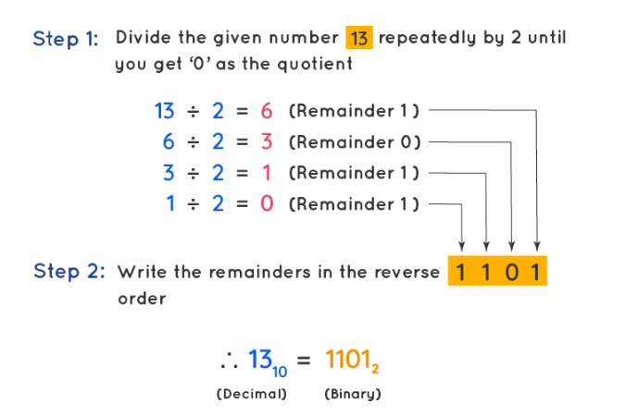
Example
Convert the decimal number 13₁₀ to binary.
Solution: We will start dividing the given number (13) repeatedly by 2 until we get the quotient as 0. We will note the remainders in order.

Slide 8
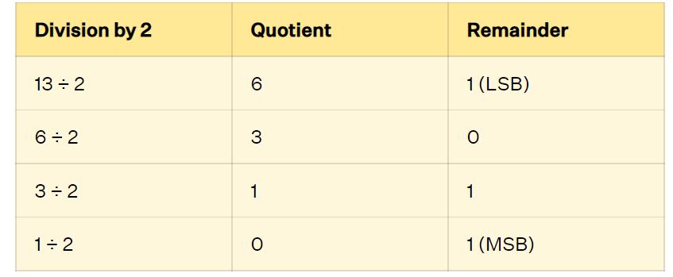
Conti…….
After noting the remainders, write them in such a way that the Most Significant Bit (MSB) of the binary number is written first, followed by the rest. Therefore, the binary equivalent for the given decimal number 13₁₀ is 1101₂. This means that 13₁₀ = 1101₂.

Slide 9
Convert 2.625 to binary.
The integer part is easy 2=10
For the fractional part
0.625 *2 =1.25 1 generate 1 and continue with the rest
0.25 *2 =0.5 0 generate 0 and continue
0.5 *2 =1.0 1 generate 1 and nothing remains.
So 0.625 = 0.101, and 2.625 = 10.101.

Slide 10
Decimal to Binary Examples
Example 1: Convert 174₁₀ to binary ( 174₁₀ is 10101110₂)
Example 2: Convert the decimal number to binary (156₁₀ is 10011100₂)
Example 3: Convert the decimal number to binary (3.703125₁₀ is 11.101101₂)

